Slide 1
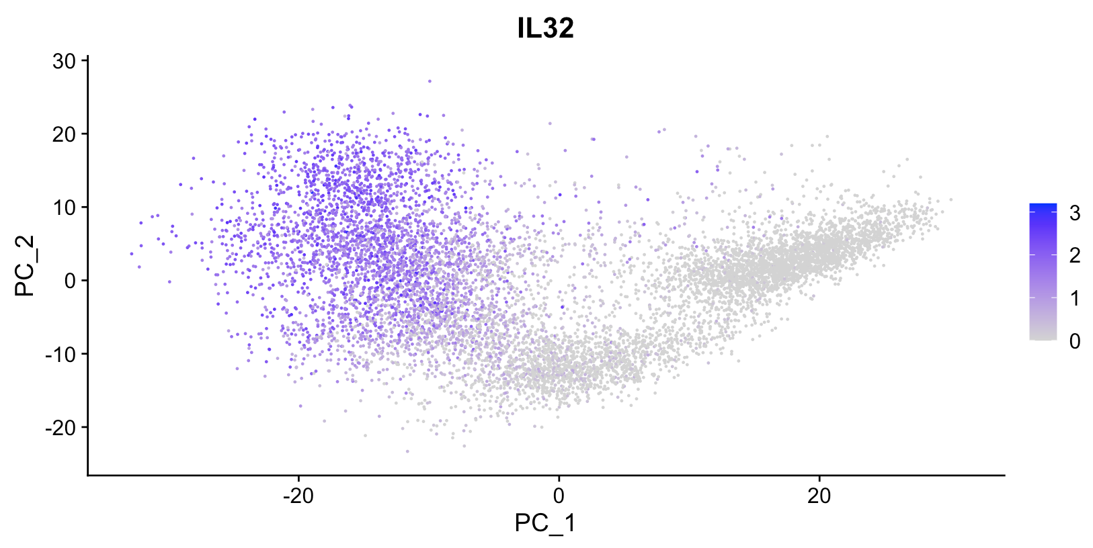
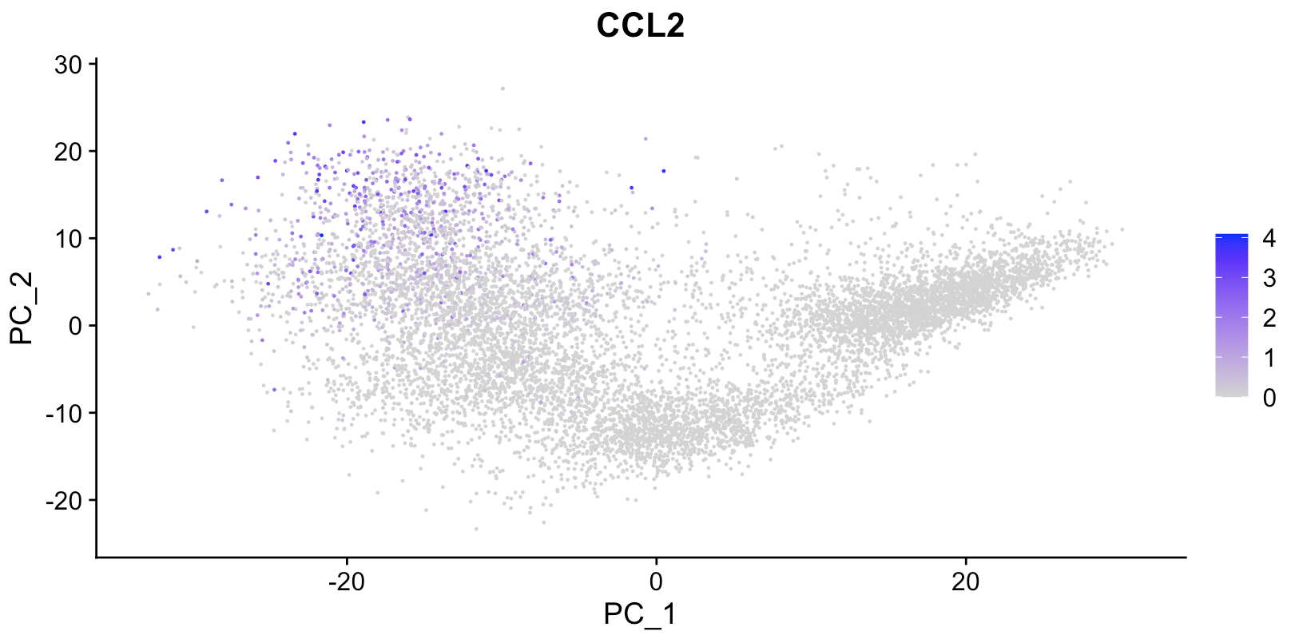
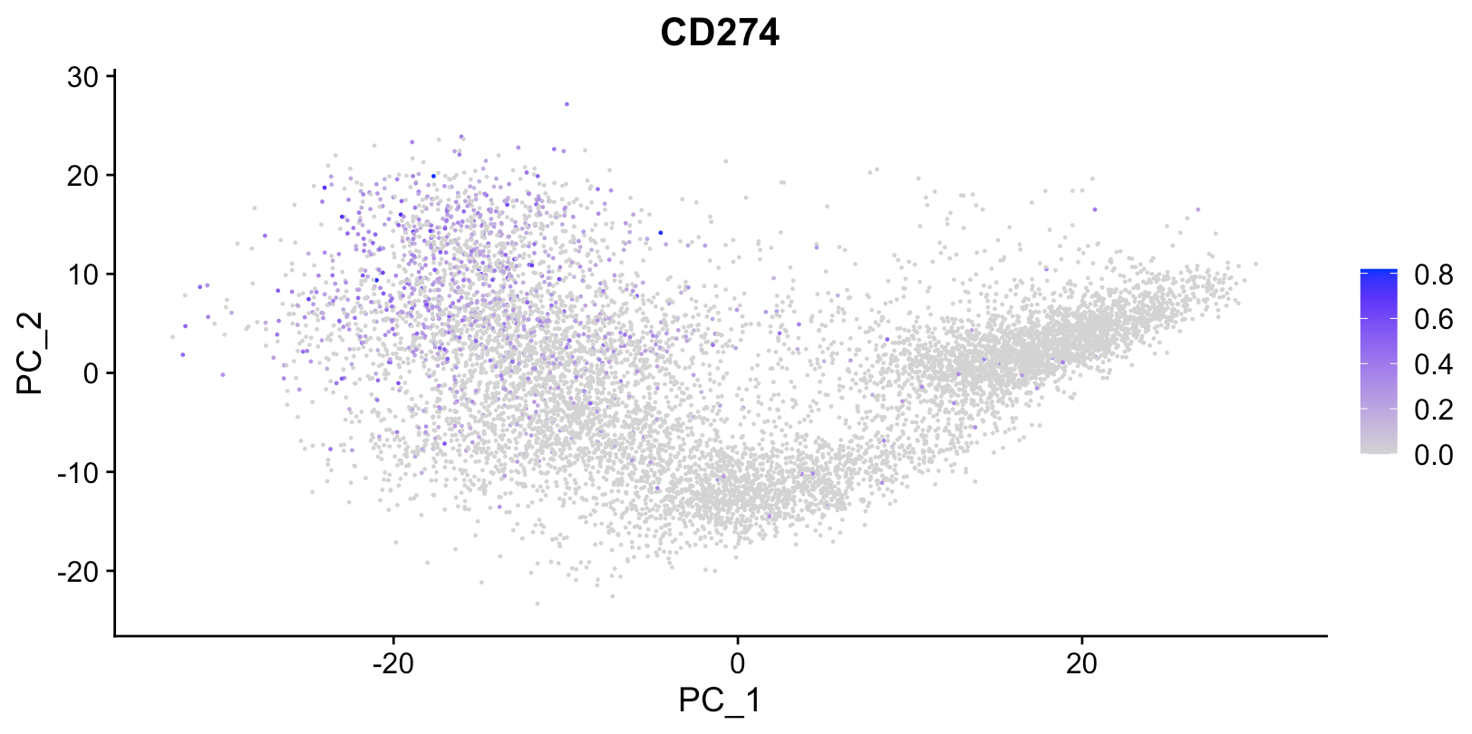
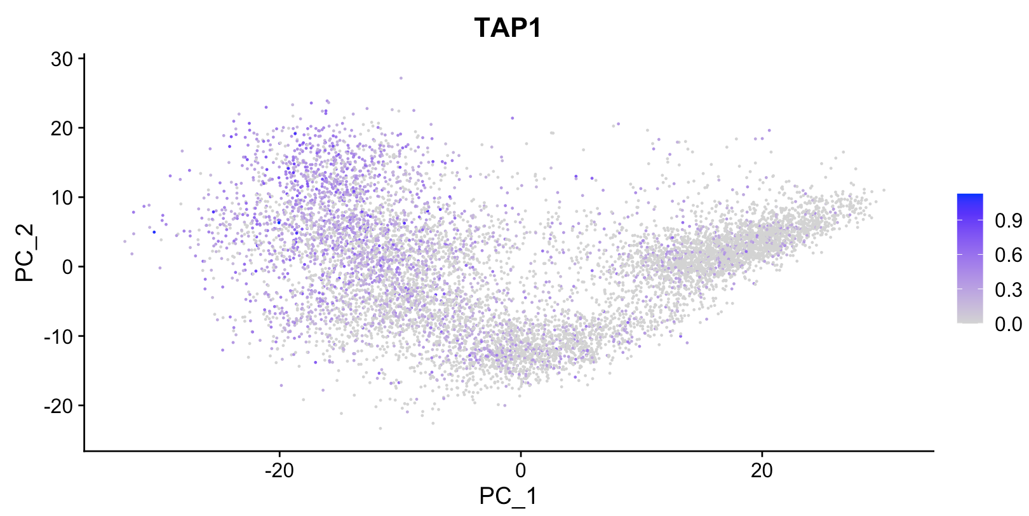
Check out my poster!
POS1.SYM-2.3
Does the EMT modulate cancer cell and immune cell cross-talk?
Desert
Excluded
Infiltrated
van der Woude et al., (2017), Trends in Cancer
EMT
IL32
CCL2
Sequencing studies from our lab have shown an increase in many immunomodulatory factors following TGFB1 treatment of OVCA420 cell line.
CD274
TAP1
PC2
Eddy Yakubovich, David P. Cook, Barbara C. Vanderhyden
PC1

Slide 2
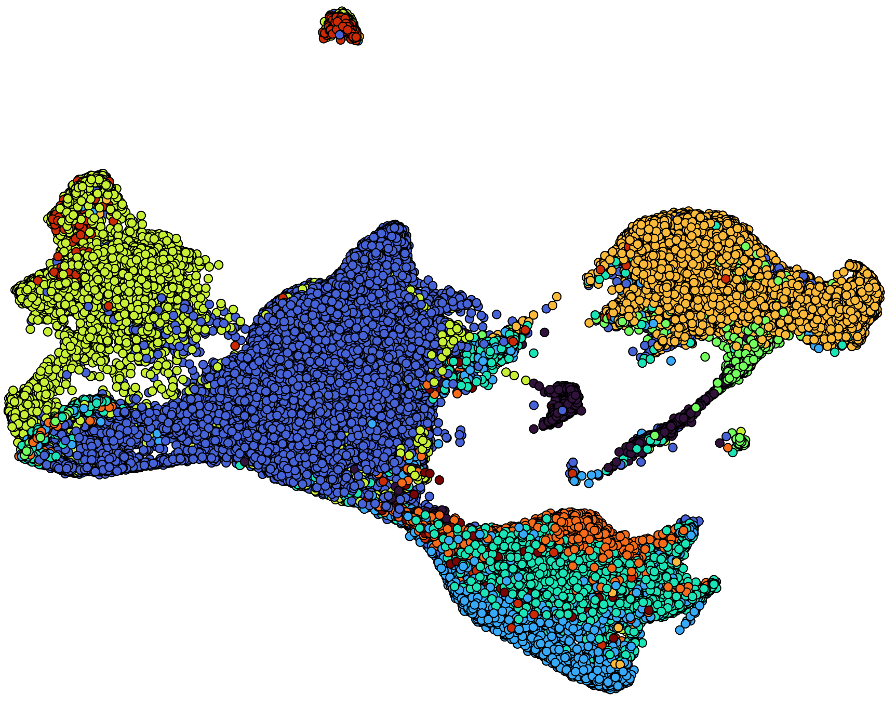
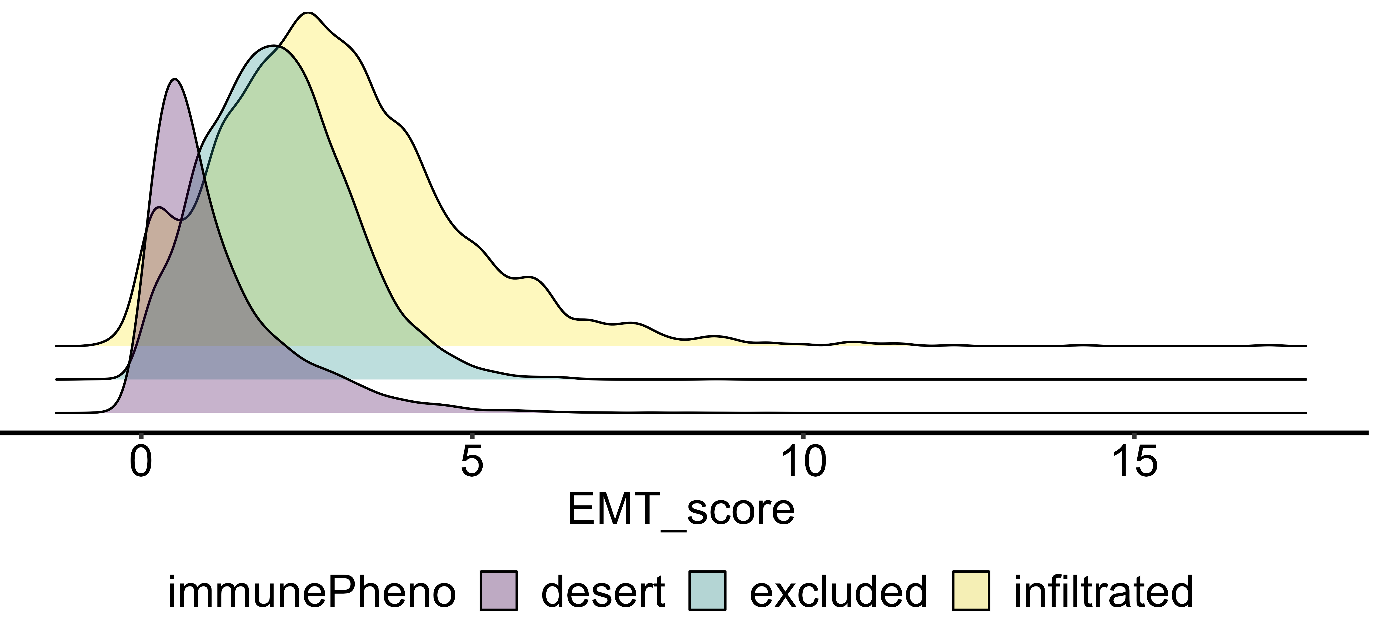
Check out my poster!
POS1.SYM-2.3
Single cell RNA-seq data confirm greater diversity of cell populations in infiltrated tumors
16 unique scRNA-Seq samples of primary HGSOC.
Pathologist-confirmed immune phenotype by histology.
UMAP2
Infiltrated tumors have the greatest diversity of cell populations, followed by excluded tumors.
UMAP1
‘Infiltrated’ cancer cells have higher EMT scores
EMT scoring using a novel cancer EMT gene set module reveals that cancer cells from the infiltrated phenotypes are most progressed on the EMT axis.

Slide 3
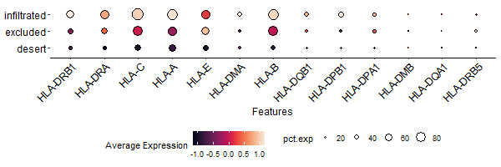
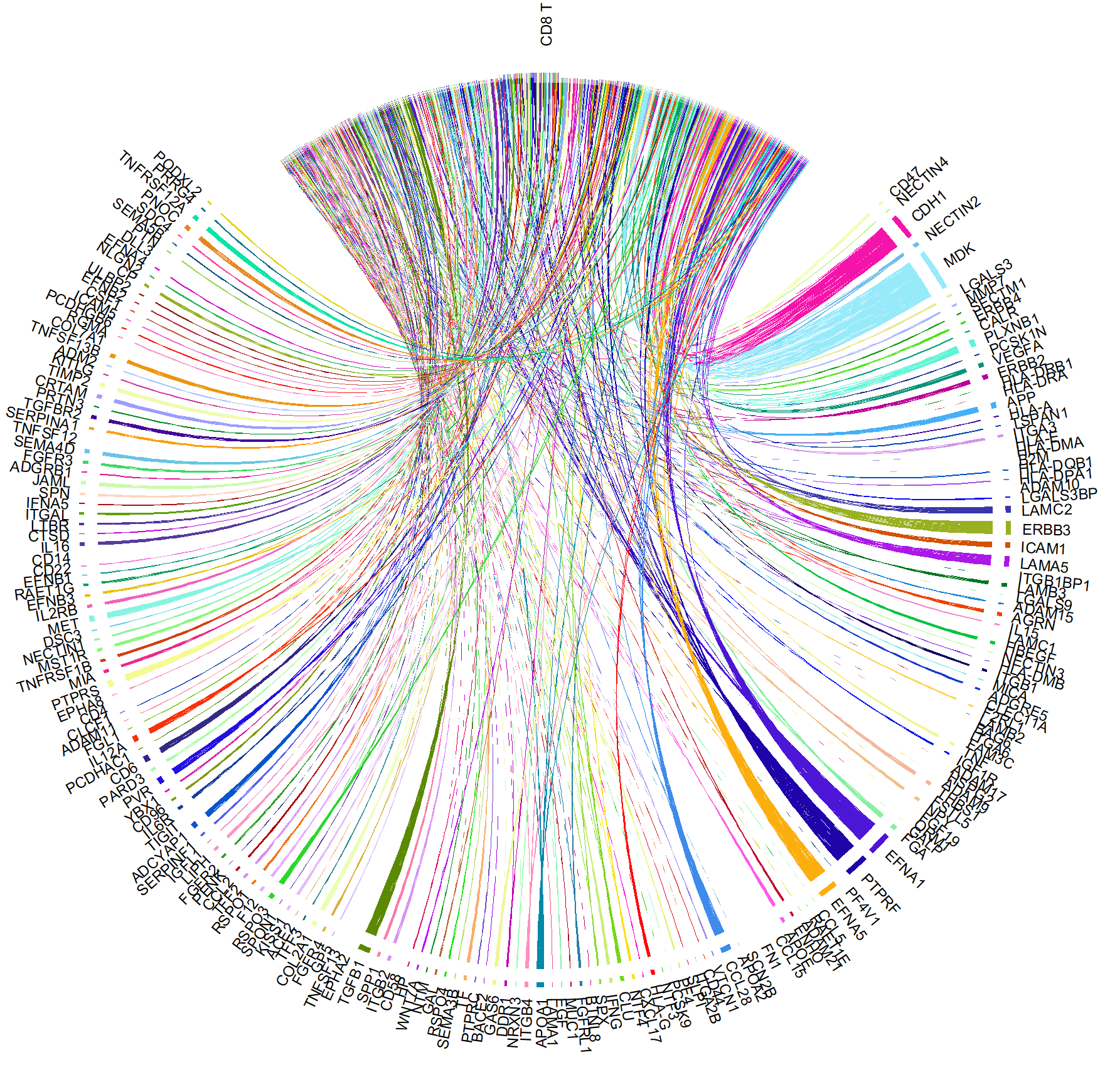
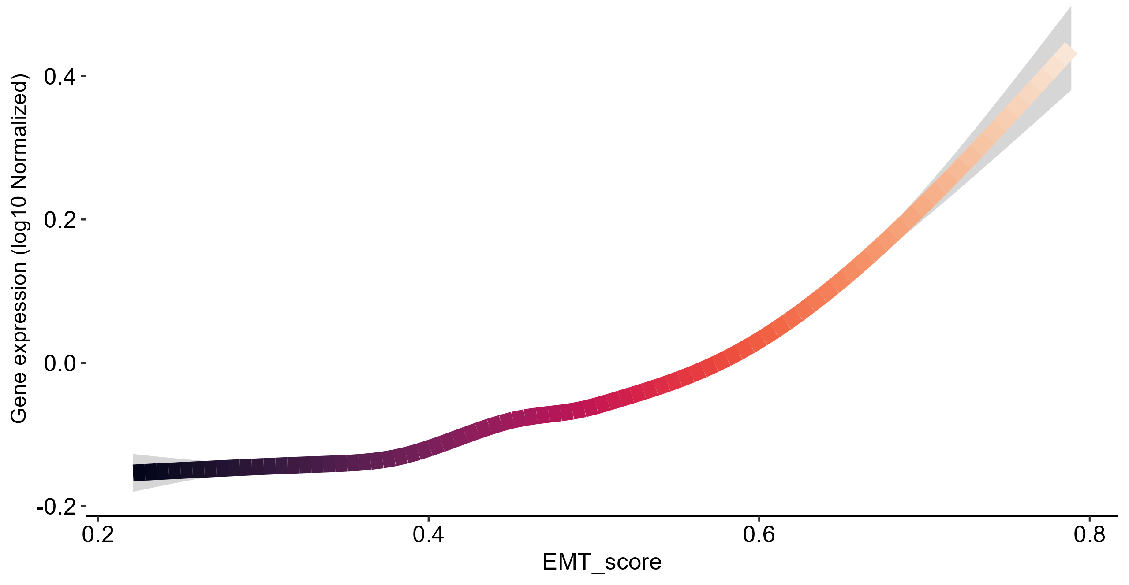
‘Infiltrated’ cancer cells have immunomodulatory phenotypes
Pathway analysis shows many immunomodulatory pathways active in the cancer cells of infiltrated tumors.
Highly upregulated pathways related to antigen presentation, cytokine/chemokine signaling, chemotaxis.
Receptor-ligand analysis reveals that MHC-I HLAs correlate with immune phenotype
CD8 T-cells
MHC-I HLAs emerge as top ligands between cancer cells and CD8 T-cells within infiltrated tumors.
HLA expression highest in infiltrated tumors.
In an in vitro model, HLA expression results from TGF-B1 treatment in absence of immune cells.

Slide 4
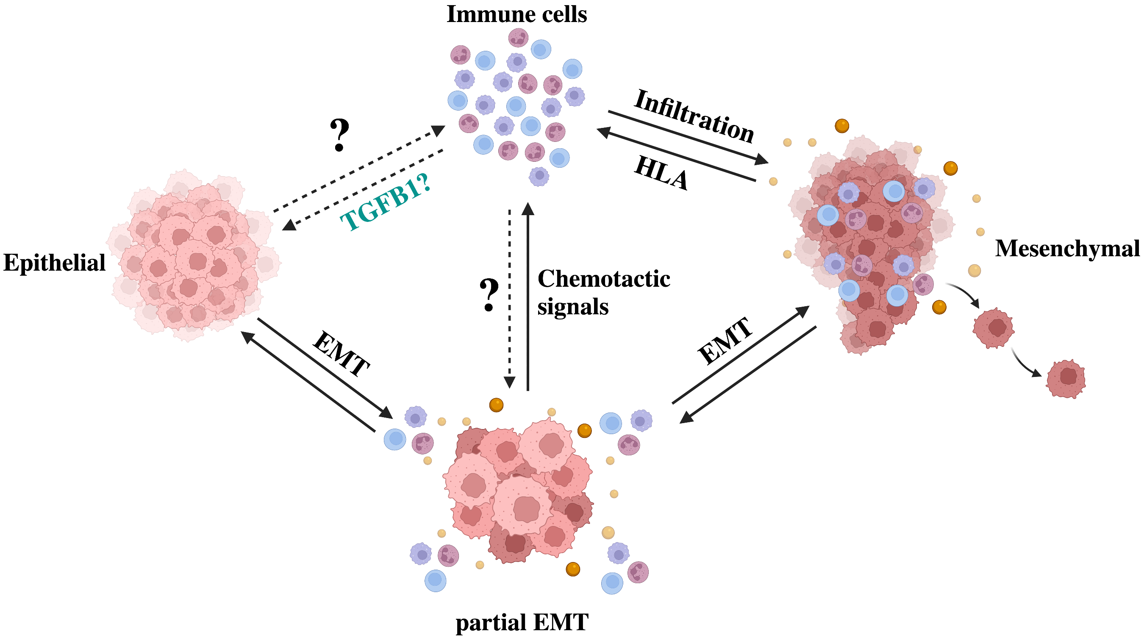
Check out my poster!
POS1.SYM-2.3
Elucidating the cross-talk
EMT and secretions?
Chemotaxis?
Infiltration?
Immune regulation?
Role of HLAs?
Eddy Yakubovich, David P. Cook, Barbara C. Vanderhyden

