Slide 1
HES1 expression limits the response of low-grade serous ovarian carcinomas to MEK inhibition
10th Canadian Conference on Ovarian Cancer Research – 10e Conférence Canadienne sur la Recherche en Cancer Ovarien
Research collaboration between Dr. René Bernards, Dr. Katrien Berns & Dr. Mark Carey laboratories
Presented by Dr. Marta Llaurado Fernandez, PhD
Research Associate & Program Manager Department of Obstetrics & Gynecology, University of British Columbia, Vancouver
Ottawa – May 27, 2022
POS-1.SYM-2.2
Notes:
Hello everybody, thanks for the invitation to present our work in this conference. Today, I will be presenting a study done in collaboration between the laboratories of Dr. Mark Carey (in Vancouver) and Drs. René Bernards and Katrien Berns (in Amsterdam), which is focus on the study of MEKi resistance mechanisms in LGSOC.

Slide 2
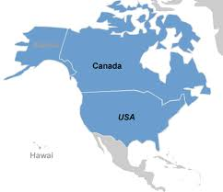
Low-grade serous ovarian carcinoma (LGSOC)
Jane
Frequency rates
Amy
140 new
cases/year
1,120 new
cases/year
Ashley
Sarah
Response rates (advanced/recurrent stage)
Chemotherapies
4%
Anti-hormone therapies
9%
MEK inhibitor therapies
26%
Lacking effective therapies
74%
Mortality rate (~70%)
Notes:
As you may know, LGSOC is rare ovarian cancer that often affects young women and is diagnosed at late stage.
As a result of its late detection and the lack of effective therapies, about 70% of these women will die of this disease.
In fact, of the 4 women affected by LGSOC shown in here, 3 of them have sadly deceived.
MEKi therapies have recently shown promising results in a subset of LGSOC patients however, however most patients lack of effective treatments.

Slide 3
Clinical gap & research question
Trametinib (MEK inhibitor) is the new standard of care for LGSOC.
Ineffective in 74% of patients;
Acquired drug resistance;
Undesired drug effects.
Can we identify genes implicated in the resistance to MEK inhibition (to ultimately improve treatment options for LGSOC patients)?
Finding a drug that synergizes with MEKi in LGSOC.
Patient-derived cell culture models
CRISPR screens
Knock in and down exps
Mice xenograft models
Notes:
As per this year, the MEKi tramentib has become the new standard of care for the treatment of advanced/recurrent LGSOC.
While this is good news, efficacy is restricted to 26% of patients and acquired drug resistance and undesired drug effects are challenges that remain to be addressed.
Thus, we aimed to optimize the use of MEKi treatment by identifying modulators of MEKi resistance in patient-derived cell cultures.

Slide 4
MEKi (trametinib) efficacy in LGSOC cell lines
Pre-clinical background
Trametinib is a potent MEKi in-vitro.
LGSOC cell lines can be classified as MEKi sensitive/resistant.
1056
1312
3448
3993
4627
4698
OvCAN 1 Research Initiative
Notes:
In our lab we have previously established and characterized a collection of LGSOC cell lines models, some of which are now part of the OvCAN research model repository lead by OCC.
Pre-clinical testing of several MEKi inhibitors allowed us to identify trametinib as the most potent MEKi inhibitor, and classify the models according to their response to this drug.
OvCAN: Advancing New Treatments to Improve the Survival of Women with Ovarian Cancer

Slide 5
Identification of genes that are implicated in
the response to MEKi in LGSOC
Partially MEKi-resistant LGSOC cell line
Highly MEKi-resistant LGSOC cell line
Gain-of-function
(SAM library targeting 23,430 gene isoforms;
3 weeks in trametinib selection)
Loss-of-function
(Brunello library targeting 19,114 genes;
3 weeks in trametinib selection)
Synthetic lethal screen
(Brunello CRISPR library, 10 days +/- trametinib, deep-sequencing)
A
SHOC2
CRISPR-Cas9 genome-wide libraries screens
Colony formation assays
Colony formation assays
Colony formation assays
Drug resistance
MALM2 overexpression
increased MEKi-Re
MAP3K1
knock down
increased MEKi-Re
SHOC2 knock down
Increased MEKi-Se
Drug resistance
Drug lethality
Llaurado M*, Hijmans EM*, Gennissen AMC*, et al. Clinical Cancer Research, Under Revision
Notes:
In this new study, aimed to optimize MEKi therapy in LGSOC, we used a collection of our LGSOC research models including de-novo and acquired MEKi-resistant cells lines and primary ascites cultures derived form advance/recurrent LGSOC patients.
Using a tripe approach,
Number of lines used in the CRISPR results? Methdos..

Slide 6
HES1 expression limits MEKi efficacy
Gain MALM2; Loss MAP3K1 → Increased MEKi resistance
Loss SHOC2 → Potentiated MEKi lethality
MALM2 overexpression
MAP3K1 knock down
SHOC2 knock down
HES1 regulation
Inactivating MEK1 mutations or HES1 overexpression was also detected in several spontaneous MEKi (trametinib)-resistant derivatives.
Llaurado M*, Hijmans EM*, Gennissen AMC*, et al. Clinical Cancer Research, Under Revision
Notes:
SHOC2 knock down potentiates MEKi (trametinib) lethality, reducing HES1 and MAPK inhibition (pERK) in MEKi-resistant LGSOC cells,
allowing to use a much lower MEKi dose to achieve a greater anti-proliferative effect.
Interestingly, activating MEK1 mutations or HES1 overexpression was also detected in several spontaneous MEKi (trametinib) resistance derivatives.

Slide 7
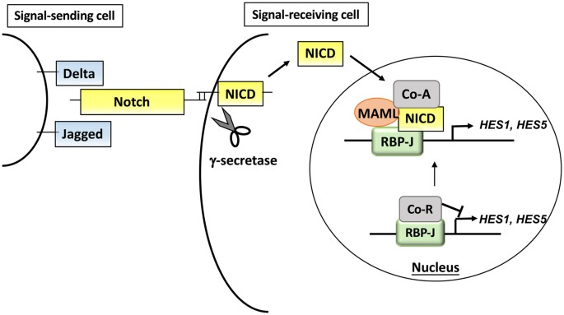
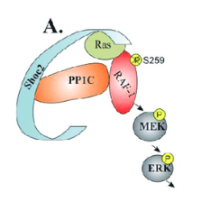
Targeting MEKi resistance in LGSOC
MALM2 inhibitor?
SHOC2 inhibitor?
JI051inhibitor
(synergistic effects with MEKi in some clones)
RAF inhibitor
MEK
inhibitor
Gamma-secretase inhibitors
(high concentrations needed)
HES1
Notes:
JI051 inhibitor: described to inhibit HES1, by stabilizing the (inactive) interaction between PHB2 and HES1. → synergistic effects in some clones
Gamm-secretase inhibitors: described to inhibit NOTCH1 cleavage and signaling, by inhibiting γ-secretase activity. → concentrations needed to inhibit NOTCH pathway were high
Jones GG et al. Nat Commun, 2019 – SHOC2 phosphates dependent RAF dimerization mediates resistance to MEK inhibitors in RAS-mutant cancers
Sulahian R et al. Cell Rep, 2019 – Synthetic lethal interaction of SHOC2 depletion with MEK inhibition

Slide 8
Dual Pan-RAF + MEK inhibition
has synergistic effects in LGSOC
Xenograft mice models
Parental LGSOC cell lines &
MEKi-resistant derivatives lines
Primary ascites cultures
Control
BGB283 5mg/kg
BGB28310mg/kg
TRAM 0.5mg/kg
Tumor volume change
BGB283 (5) +TRAM (0.5)
In-vitro
In-vivo
BGB28310mg/kg
TRAM 0.5mg/kg
BGB283 (5) +TRAM (0.5)
Tumor volume change
-30%
Pan-RAFi (BGB283) synergizes with MEKi (trametinib), both in-vitro and in-vivo in LGSOC models.
This drug combination allows to use MEKi at lower doses than the maximum tolerated dose used in the clinical recent trials.
Notes:
Simultaneous inhibition of MAPK and NOTCH pathway also enhanced MEKi efficiency in melanoma (increased downregulation of pERK and HES1).
And MEKi+BRAFi combination is the gold standard in malignant melanoma.
In 2020, a complete response to this drug combination was reported in an advanced LGSOC patient.
Main study findings:
MALM2, MAP3K1 modulate MEK resistance (through HES1).
SHOC2 knock down enhances MEKi efficacy.
In the absence of a SHOC2 inhibitor, dual MEK + PanRAF inhibition may provide a promising treatment strategy for advanced/recurrent LGSOC patients.
Clinical significance:
Increase of MEKi drug efficacy,
Potential reduction of undesired drug side effects,
Reduction of unnecessary treatment associated costs.
Next steps:
Clinical validation.

Slide 9
The Carey Lab, Research Collaborators & Funders
Dr. Mark Carey
Madison Bittner
Hannah Kim
Aleksandra Hamilton
Lilly McLellan
Annabel Chen
Dr. Nelson Wong
Dr. Marta Llauradó
Dr. Chen-Han Lee (BCCA)
Dr. Collin Collins (VPC)
Dr. Yuzhuo Wong (BCCA)
Dr. René Bernards (NKI)
Dr. Katrien Berns (NKI)
Canadian LGSC-CoP
International Consortium LGSC
& Other Research Collaborators
Notes:
Thanks all for your attention!
Special thanks to all patients, advocates, funders & collaborators that have participated in these studies

